Slide 1

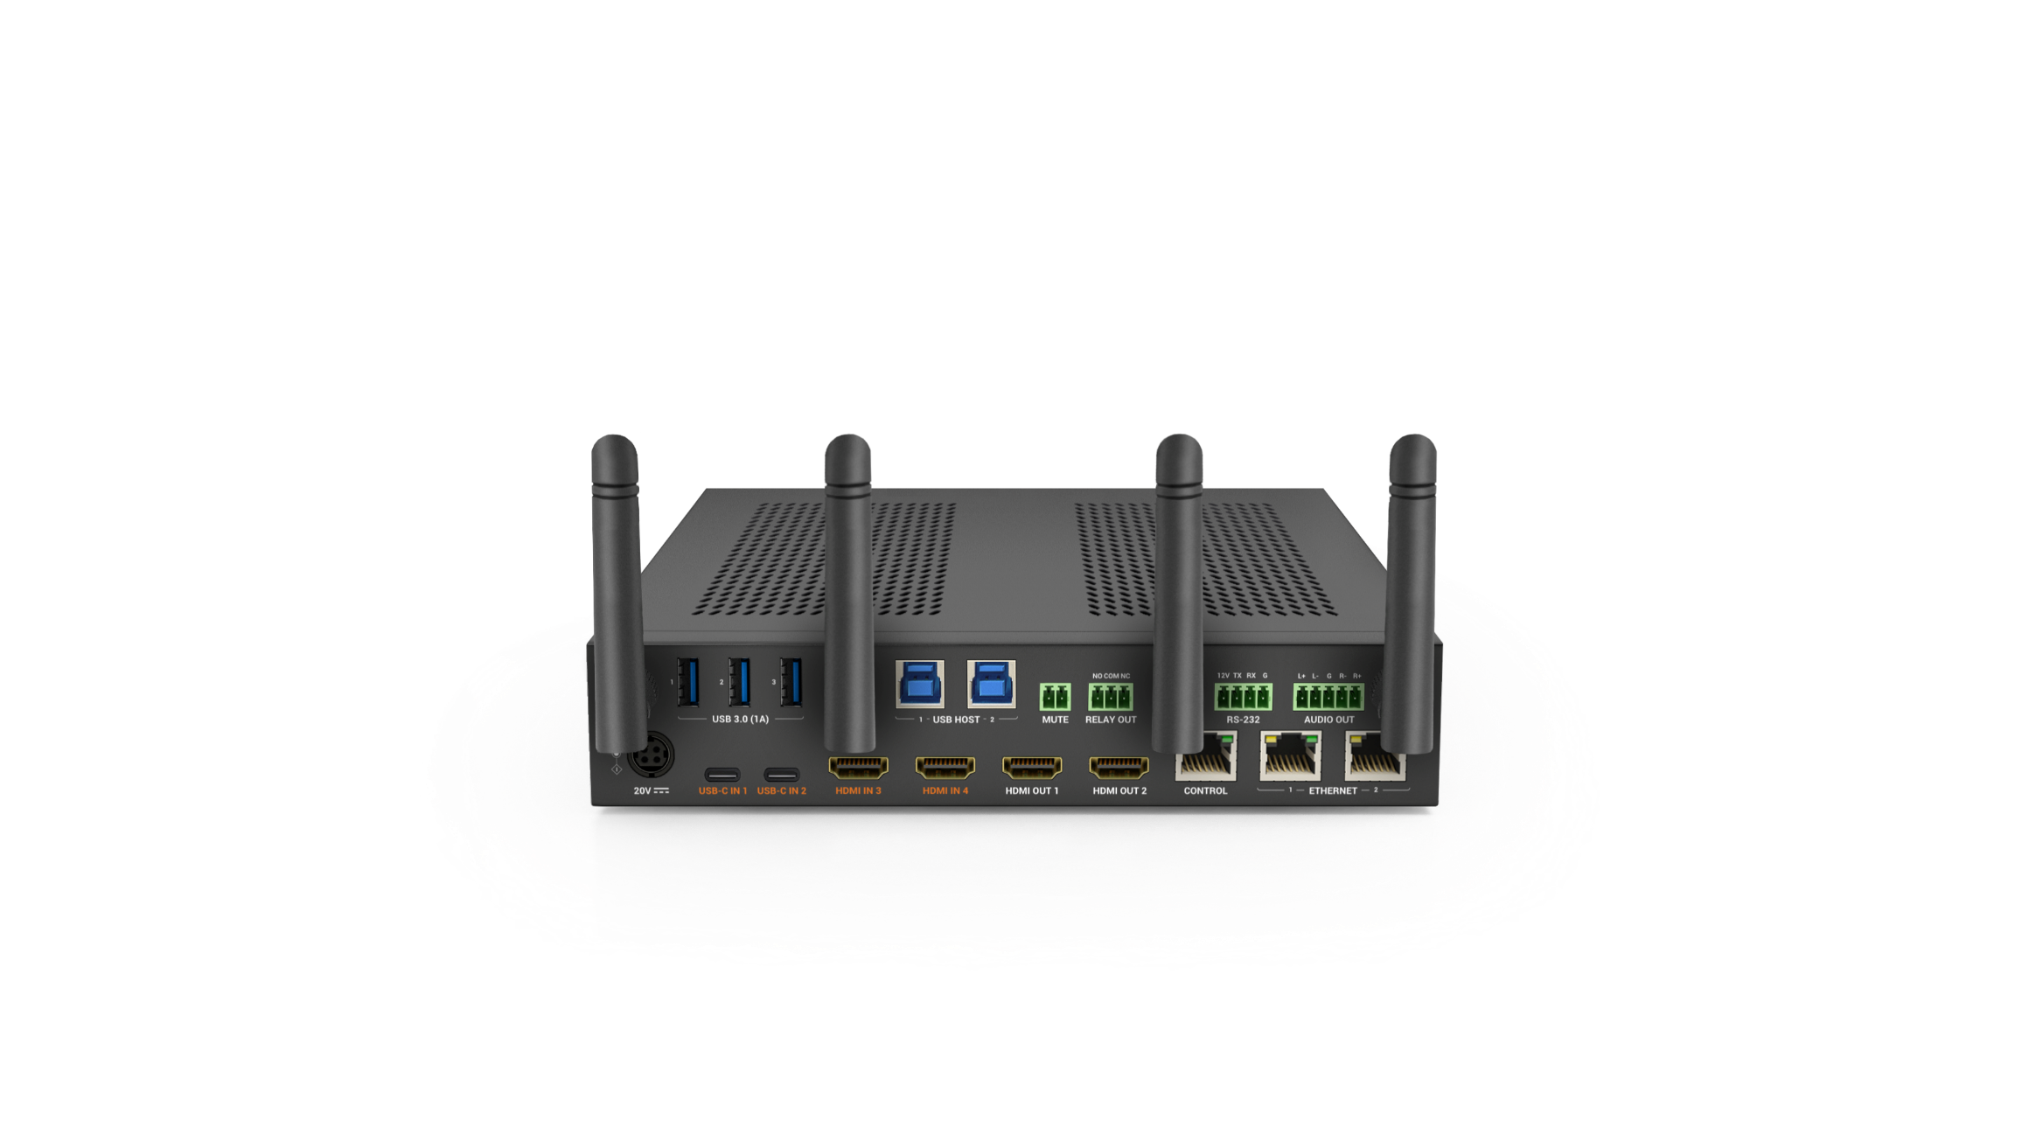
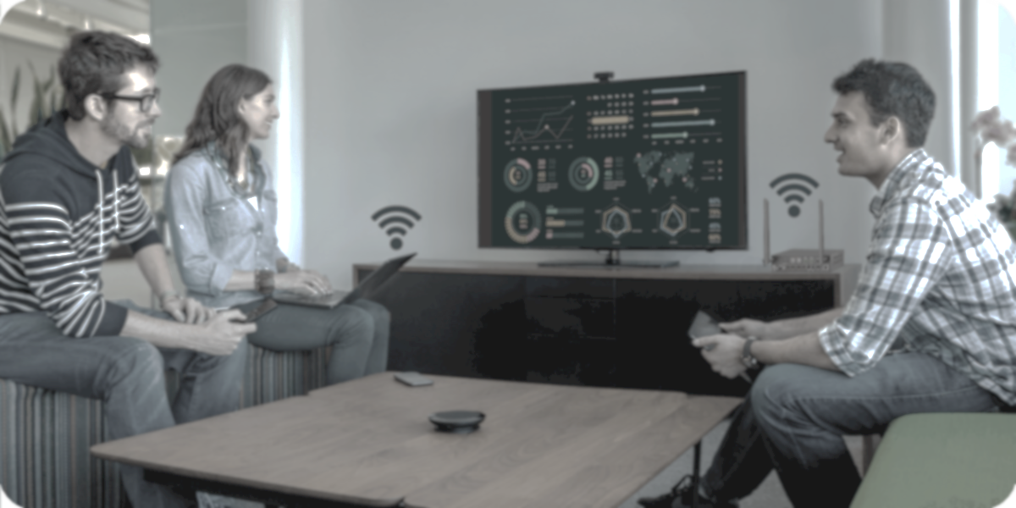
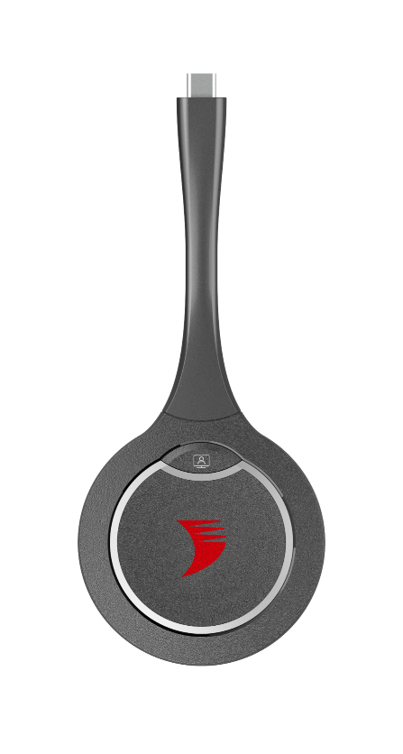

SW-640L-TX-W & APO-DG2 / APO-DG2-PRO
Product Guide
Wireless Presentation and Conferencing System
Award-Winning Audio-Visual Solutions Manufacturer
Notes:
1. 更新封面，不需要展示产品；

Slide 2

Contents
Product Overview & Key Features
Why Choose Us?
Interface & Specifications
Typical Connection & Applications
Comparison Analysis
Quick Installation Guide & Web UI Introduction
Q & A Session
Powerful · Reliable · Simple

Slide 3
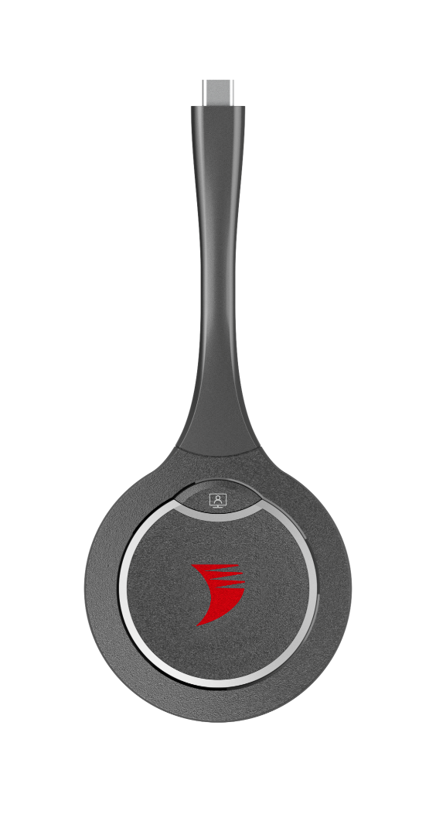

Product Overview
Powerful Wireless Presentation and Conferencing System
The “SW-640L-TX-W” wireless presentation switcher, when paired with the APO-DG2 or APO-DG2-PRO USB-C casting dongle, forms a powerful 4K wireless presentation and conferencing system. This setup ensures a seamless and superior hybrid meeting experience.
Built on the strengths of its predecessors, the SW-640L-TX-W offers 2x full-featured USB-C inputs and 2x HDMI inputs/outputs, providing unparalleled flexibility and options.
This system is ideal for small to medium-sized meeting rooms and classrooms, effortlessly meeting diverse practical needs and enhancing overall efficiency.
Powerful · Reliable · Simple

Slide 4









Main Features
Reliable and High-Quality Resolution
4K resolution guarantees sharp and clear video, delivering a fully immersive presentation experience.
Balanced Audio De-embedding
Independent de-embedding audio works seamlessly with external audio systems. When paired with a professional amplifier, speaker, and mic, it creates a more immersive audio experience for presenters and participants.
Comprehensive Input Options
Offers a variety of inputs, including USB-C and HDMI, ensuring compatibility with devices used in conferences, meetings, and educational settings.
Full-Featured USB-C Support
The USB-C port provides 60w charging, network, video, and USB transmission through a single cable, simplifying connections and maintaining a clean and tidy workspace.
Multiview & MST Support
Displays up to 4 video sources simultaneously when single screen connection. MST over one USB-C cable provides two extension displays with dual HDMI outputs.
Versatile and Flexbile Ethernet
Advanced Ethernet capabilities provide a reliable network environment, enhancing interactive experiences, especially during hybrid meetings and education. Ethernet Bridge and Ethernet Isolation ensure a stable and secure usage experience.
Wireless Casting Support
Supports multiple presentation methods for classes or meetings, including Airplay mirroring, Miracast, and Dongle.
KVM Switch for Display
Includes USB 3.0 (Device and Host) ports for cameras, speakerphones, and keyboards. Perfect for hybrid meetings and education, it simplifies cable management and allows easy switching between devices using a single hub, streamlining workflows.
Centralized Control and Automation
Offers various control methods, such as RS232, Relay, API, and Web-UI, enabling remote monitoring and control of the presentation system. Provides real-time access to system status, configuration, and performance.
Powerful · Reliable · Simple

Slide 5
Why Choose Us: 1. One-Click Wireless Conferencing
Transform your meeting room with one-click wireless conferencing, ensuring easy connectivity, seamless integration, and enhanced productivity.
Effortless Connectivity
Seamless Integration
With just a single click of the button on the
APO-DG2/APO-DG2-PRO USB-C dongle, you can control your USB conferencing devices wirelessly, eliminating the hassle of tangled cables.
Works flawlessly with cameras, speakerphones, video bars, touch-screen panels, and other USB 3.0 peripherals, delivering a seamless and superior hybrid meeting experience.
Boost Productivity
High-Quality Performance
Quickly transition between meetings with minimal setup time, ensuring a smooth and productive workflow.
Guarantees clear and reliable audio-visual communication, essential for effective collaboration and decision-making.
Powerful · Reliable · Simple

Slide 6
Why Choose Us: 2. Easy Sharing and Collaboration for Everyone
Make screen sharing, collaboration, and interaction easier for everyone, supporting various devices and operating systems to enhance interaction and engagement.
Multiple Casting Methods
Universal Compatibility
Supports AirPlay, Miracast, USB-C dongle, and HDMI/USB-C wired connection, catering to various user preferences and devices.
Works seamlessly with laptops, tablets,
and smartphones, supporting major operating systems like Windows, macOS, and Android.
Interactive Learning
Engage Your Audience
Perfect for classrooms, enabling teachers to quickly showcase teaching content while allowing students to interact using their own devices.
Multiview support displays up to 4 sources simultaneously, making collaborative work and data comparison easier and more efficient.
Powerful · Reliable · Simple

Slide 7
Why Choose Us: 3. Plug & Play, Guest-Friendly
Simplify setup with plug-and-play functionality, making it easy for guests to connect and present without any hassle.
Simplified Setup
Versatile Input Options
Plug-and-play functionality means guests can easily connect without the need for additional software or complex configurations.
Featuring 2x full-featured USB-C ports (60W PD for guests’ laptops) and 2x HDMI inputs, it provides unparalleled flexibility for various presentation needs.
Present in Seconds
Secure Network Access
Guests can simply pick up the dongle on the table and instantly share their screen, ensuring a swift and efficient presentation process.
Switch to “Isolated Mode” for network settings when you need to separate your internal network with guests’ network. It ensures your guests can access network securely and stably, even while you are configuring the system.
Powerful · Reliable · Simple

Slide 8
Why Choose Us: 4. Effortless Device Management
Centralize and simplify device management to ensure a smooth and efficient operation for all your conferencing needs.
Centralized Control
Remote Configuration
Manage and monitor all connected devices through an intuitive web interface or all-in-one touchpad controller, simplifying the administration process.
Configure the system remotely via SYGMA cloud device management, ensuring that everything runs smoothly without needing to be physically present.
Flexible Network Settings
More Advanced Control
The presentation device is engineered with 3x Ethernet ports. Switch to “Isolated Mode” for enhanced security and network stability, ideal when you need to separate your internal network with guests’ network. Or, go for “Transparent Mode” for hassle-free networking and flexible connections, perfect for efficient communication without restrictions.
Utilize the "mute" port to connect to a PA sensor, allowing for quick muting of audio on HDMI OUT 1-2 and analog audio outputs during emergency broadcasts. Additionally, the "Relay Out" interface enables connection to a relay device for controlling functions such as raising or lowering the projection screen.
Powerful · Reliable · Simple

Slide 9
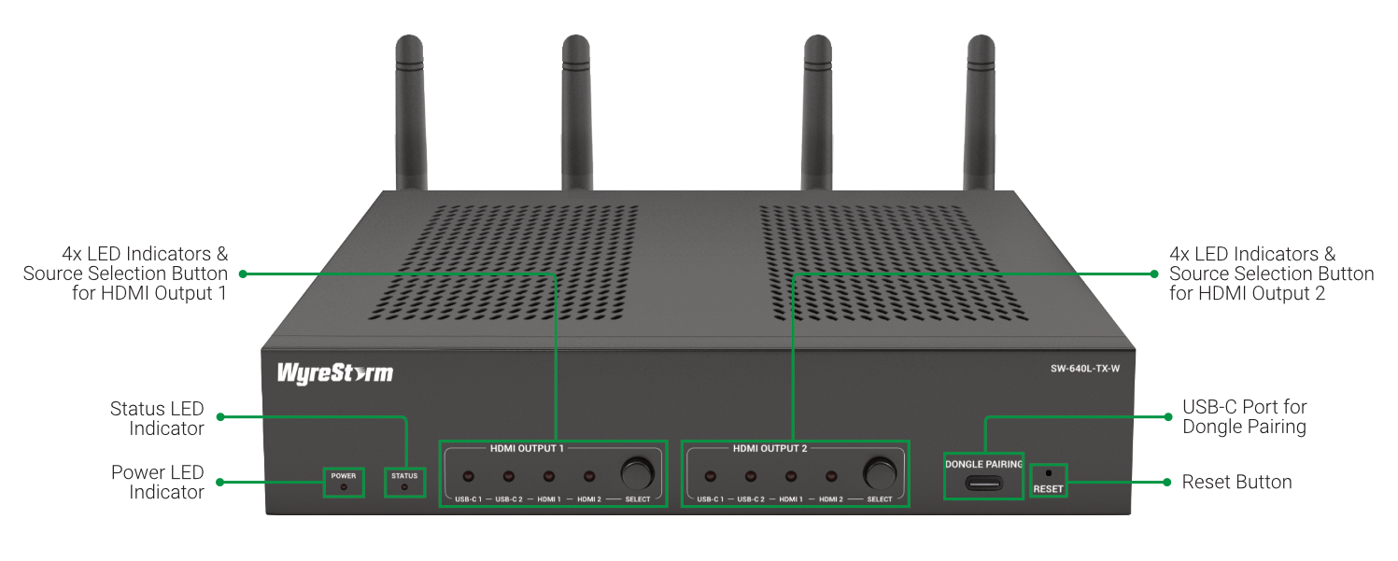
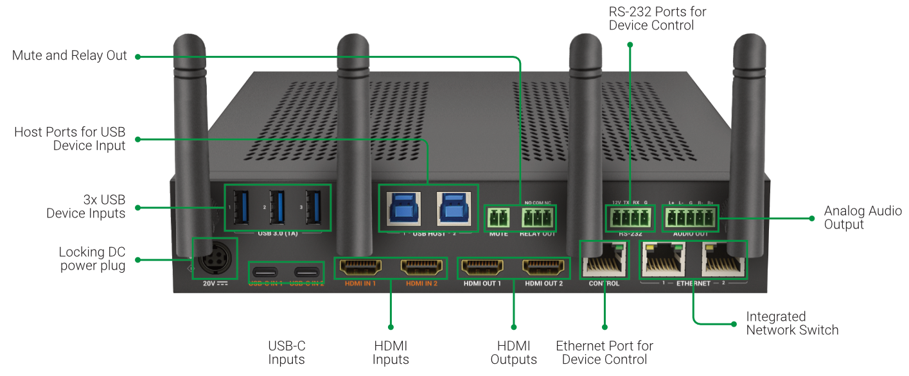
Interface of the Product
Front Panel
Featuring:
3 Ethernet Ports
Ensures secure and stable network access for guests using their PCs, while allowing easy configuration of the system via a web interface.
Mute
Connect to the PA sensor to quickly mute audio on HDMI OUT 1-2 and analog audio out, in case of an emergency broadcast.
Relay Out
Connect to a relay device for relay control, such as raising or lowering the projection screen.
Rear Panel
Powerful · Reliable · Simple

Slide 10
Specifications & Packing List
Main Specifications
Input Video Port | 2x USB-C, 2x HDMI
Output Video Port | 2x HDMI
Output Video Signal | HDMI OUT 1: HDMI 2.0, HDCP 2.2 HDMI OUT 2: HDMI 1.4, HDCP 1.4
Input Resolutions (Maximum) | USB-C/HDMI:3840x2160 (2160p30) Miracast:1920x1080 (1080p60) Airplay Mirroring: Up to 1920x1080 (1080p60) Dongle : 3840x2160 (2160p30)
Output Resolutions (Maximum) | HDMI OUT 1:3840x2160 (2160p60) HDMI OUT 2:3840x2160 (2160p30)
Input Audio Port | 2x HDMI, 2x USB-C, 3x LAN, 2x Wi-Fi
Output Audio Port | 2 x HDMI, 1 x Analog Audio Out
Control Method | Front panel buttons, LAN (Web UI & Telnet API), RS-232
Power Supply | 20V 10A DC
What’s in the Box?
1x SW-640L-TX-W
1x 20V/10A Power Supply (US/UK/EU/AU)
4x Plastic Mounting Brackets
1x 2-pin Phoenix Connector (for PA Sensor)
1x 3-pin Phoenix Connector (for Relay)
1x 4-pin Phoenix Connector (for RS-232)
1x 5-pin Phoenix Connector (for Audio Out)
4x Wi-Fi Antennas
1x Quick Start Guide
Powerful · Reliable · Simple

Slide 11
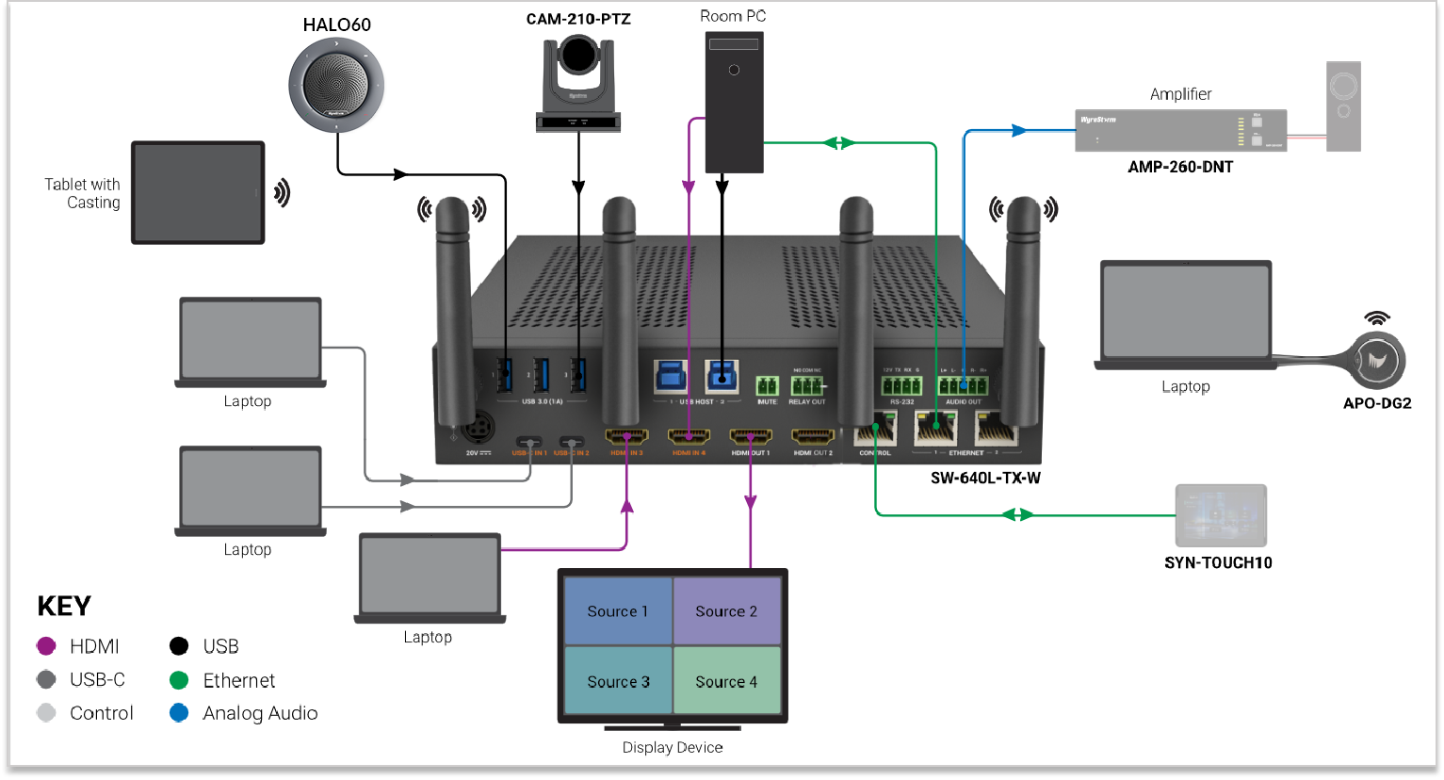
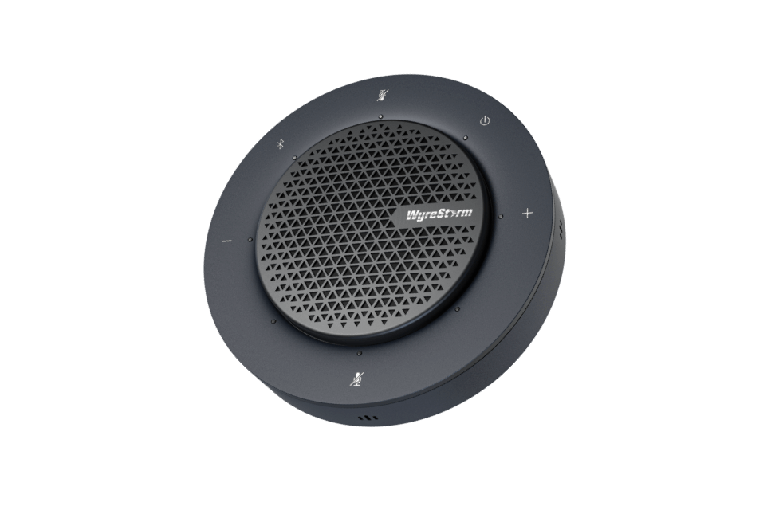
Typical Connection & Applications
The SW-640L-TX-W system seamlessly integrates with all your conference devices, like room PCs, laptops, displays, webcams, speakerphones, and amplifiers, fulfilling every requirement for video presentations and remote conferencing. Please refer to the typical connection diagram below.
HALO 80

Slide 12
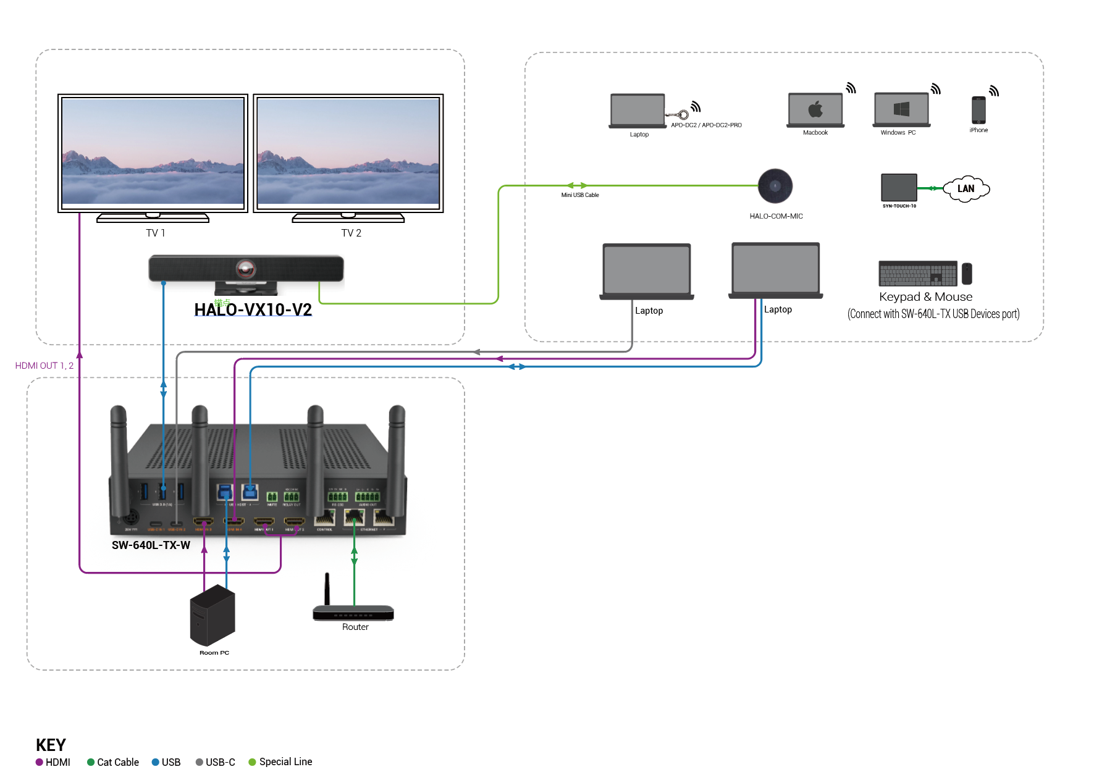

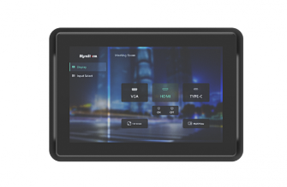
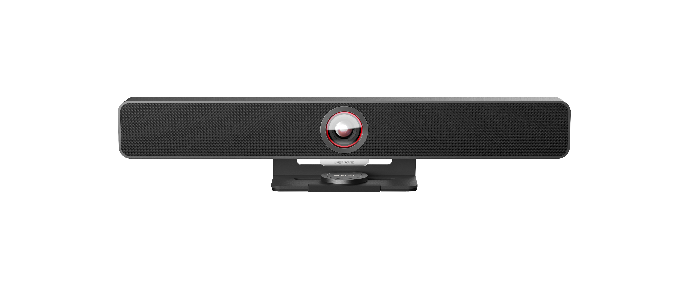

Typical Connection & Applications
Application Scenario 1: Medium Conference Room
This solution simplifies installation with its plug-and-play design, significantly enhancing meeting efficiency for both in-person and remote conferencing, ensuring every meeting is productive and smooth.
Key Benefits Include:
Multiple Casting Methods: Simplifies presentations with various casting options.
All-in-One Video Bar: Provides superior audio and video quality.
Smart Panel: One-click control for all functions.
Dual-Screen Connection: Ensures clear and comprehensive display.
Fast Seamless Switching: Quick and smooth transitions between inputs.
What’s included in the solution?
SYN-TOUCH10 v2
APO-DG2/APO-DG2-PRO
HALO VX10 v2
HALO-COM-MIC

Slide 13
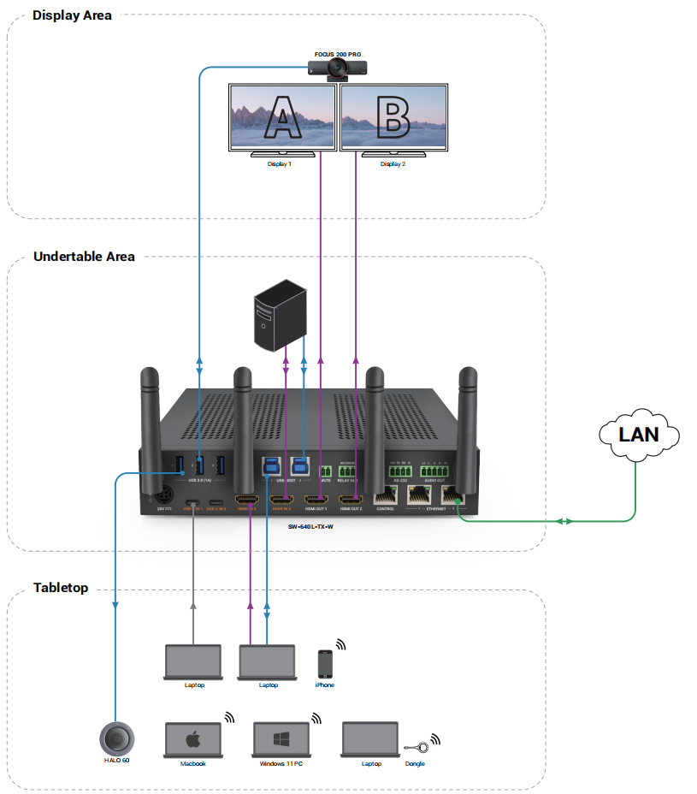
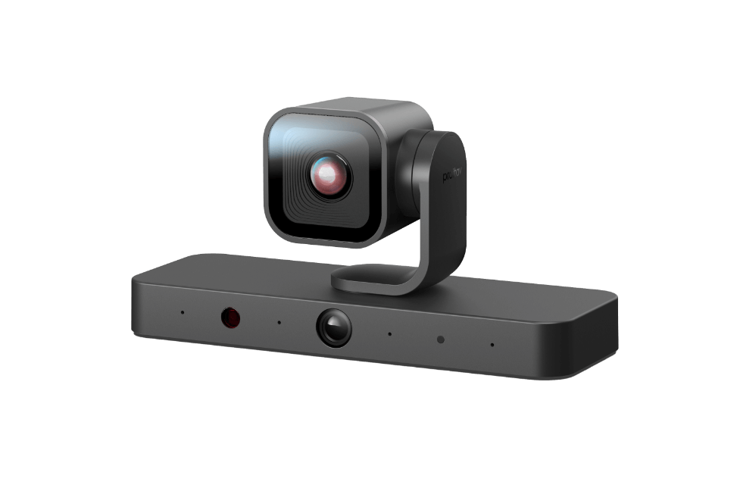
Typical Connection & Applications
Application Scenario 2: Small Classroom
This solution empowers teachers to effortlessly and quickly showcase teaching content while enabling students to interact using their own devices, enhancing overall classroom efficiency and engagement.
Key Benefits Include:
Multiple Casting Methods: Simplifies presentations with various casting options.
Dual-Screen Connection: Ensures clear and comprehensive display.
Full-Featured USB-C: .Provides 60w charging, AV, USB, network transmission over one USB-C
Fast Seamless Switching: Quick and smooth transitions between inputs.
CAM-420-PTZ
What’s included in the solution?
APO-DG2 / APO-DG2-PRO
CAM-420-PTZ
HALO 80
HALO 80
Powerful · Reliable · Simple

Slide 14
Comparison with Other Competitors
 | WyreStorm SW-640L-TX-W | Barco CX-50 2 Gen | Creston AM-3200-WF | Barco CX-50 | Extron Share Link Pro 1100
Video Input | 2x USB-C (Video, USB, Ethernet, Charging) & 2x HDMI | 1x USB-C (Video only) | 1x HDMI | 1x HDMI | 1x HDMI
Input Timing | 4K@30Hz | 4K@30Hz | 1080P@60Hz | 1080P@30Hz | 4K@30Hz
Video Output | 2x HDMI | 1x HDMI or 1x USB-C | 1x HDMI | 1x HDMI | 1x HDMI
Output Timing | 4K@60Hz (HDMI OUT1) | 4K@60Hz | 4K@60Hz | 4K@30Hz | 4K@30Hz
Wireless Casting by Dongle | Plug & Play, software-free | Non plug & play, software-dependent | Plug & play, software-free | Non plug & play, software-dependent | Unsupported
Dongle Casting Timing | 4K@30Hz | 4K@30Hz | 4K@30Hz | 1080P@60Hz | N/A
Wireless Conference | Supported, software-dependent | Supported, software-dependent | Supported, software-free | Supported, software-dependent | Unsupported
KVM Host | 2x USB 3.0 Type-B 2x USB 3.0 Type-C | Unsupported | 1x USB 3.0 Type-B | Unsupported | Unsupported
KVM Device | 3x USB 3.0 Type-A | 2x USB 3.0 Type-A 1x USB 3.0 Type-C | 1x USB 3.0 Type-A 1x USB 2.0 Type-A | 3x USB 2.0 Type-A 1x USB 2.0 Type-C | 1x USB 3.0 Type-A 1x USB 2.0 Type-A
Host Switching | Yes | No | Yes | No | No
Network Access | 3x RJ45 2x Built-in USB-C input Supports port-based physical network isolation, high security. | 1x RJ45, 2.5G | 2x RJ45 Guest-only network | 1x RJ45 | 2x RJ45 Guest-only network
Multiview | Quad View | Dual View | Quad View | Dual View | Quad View
RS232 | Yes | No | Yes | No | Yes
Relay | Yes | No | No | No | No
Panel Control Button | Yes | No | Yes | No | Yes

Slide 15
Comparison with Wyrestorm Wireless Conference System
 |  | SW-620-TX-W | SW-640L-TX-W | SW-220-TX-W
Video Feature | Video Input | 1x HDMI 1x USB-C (Video, USB, Ethernet, 100W Charging, MST) | 2x HDMI 2x USB-C(Video, USB, Ethernet, 60W Charging, MST) | 1x HDMI 1x USB-C
 | Max. Input Resolution | 4K@30Hz | 4K@30Hz | 4K@30Hz
 | Video Output | 2x HDMI | 2x HDMI | 1x HDMI
 | Max. Output Resolution | 4K@60Hz | 4K@60Hz | 4K@30Hz
Wireless Collaboration | Wireless Casting Dongle | APO-DG2/APO-DG2-PRO | APO-DG2/APO-DG2-PRO | APO-DG1
 | Max. Dongle Casting Resolution | 4K@30Hz | 4K@30Hz | 1080P@30Hz
 | Wireless Conference | Supported | Supported | -
 | Max. Wireless Conferencing Resolution* | 1080P@30Hz | 1080P@30Hz | -
USB Feature | USB Host | 1x USB 3.0 Type-B 1x USB 3.0 Type-C | 2x USB 3.0 Type-B 2x USB 3.0 Type-C | 1x USB 2.0 Type-C
 | USB Device | 3x USB 3.0 Type-A | 3x USB 3.0 Type-A | 2x USB 2.0 Type-A
Network Feature |  | 2x RJ45(Supports network isolation)​ 1x USB-C&1x USB3.0 Type-B​ (Wired network to PCs) | 3x RJ45(Support network isolation)​ 2x USB-C(Wired network to PCs)​ | 1x RJ45
Multiview Feature |  | Dual View | Quad View | Dual View
*Max. resolution that USB camera can transmit wirelessly to your host by Dongle

Slide 16
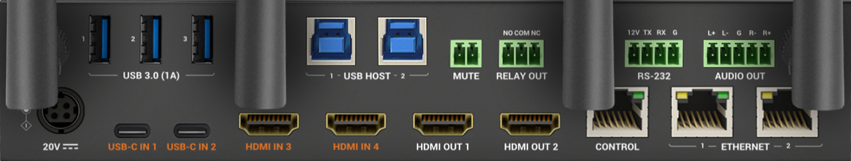
Our Advantages
This versatile system can meet all signal transmission demands in conference or classroom settings, ensuring efficient, high-quality performance for all your presentation and conferencing needs.
Our key advantages include:
2x Full-Featured USB-C Ports: Provides audio/video support, USB data transfer, 60W power supply, and 1G network connections via a single USB-C cable, accommodating up to 2 laptops.
Multiview & MST Support: Display up to 4 sources on a single TV with different layout options for diverse display needs.
3x Ethernet Ports: Ensures secure and stable network access for guests using their PCs, while allowing easy configuration of the system via a web interface.
2x HDMI Outputs: Provides flexible output options.
Cost Effective: All-in-one system at a competitive price.
Powerful · Reliable · Simple

Slide 17
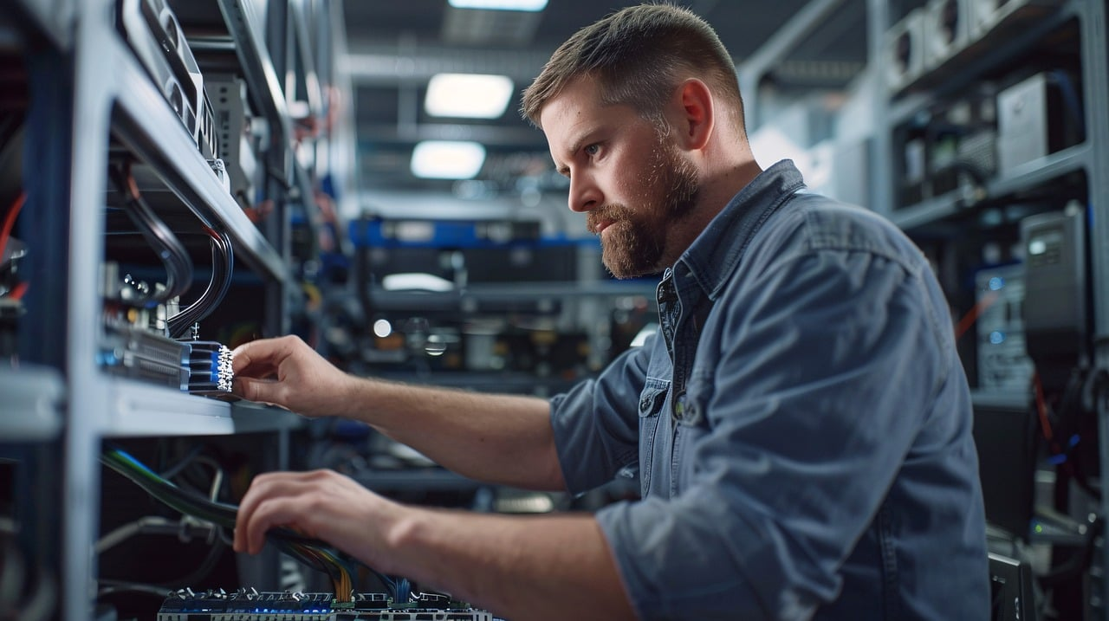
Quick Installation Guide
To install the presentation device, it simply takes 4 steps below:
Connect and Plug in: Follow the wiring instructions in the presentation device’s quick start guide: connect the device’s power interface, in-room PC, display and other conferencing devices (e.g. USB camera, speakerphone, video bar), then plug in the power adapter to turn on the device.
Wired Connection: If you prefer wired connection, use USB-C or HDMI+USB cables to connect your laptop to the presentation device, then your laptop contents will be shown on the display screen.
Pair the Dongle: Plug the dongle into the presentation device’s front pairing port, then they will get paired automatically.
Wireless Casting and Conferencing: Plug the dongle into your own laptop, then click the “casting” button to share your screen, and click the “conferencing” button to control USB peripherals wirelessly.
Powerful · Reliable · Simple

Slide 18

Quick Installation Guide
Important Notes for Installation
The APO-DG2-PRO dongle doesn’t require any software or driver for wireless conferencing.
The APO-DG2 dongle requires software installation on your laptop for wireless conferencing.
For Windows Laptops:
Insert the dongle. The system will automatically prompt you to install the software.
Click "Confirm" to begin the installation, which will run in the background until complete.
If no prompt appears, navigate to the "Devices and drives" section in "My Computer" to locate and install the software package.
For MacBook:
Insert the dongle. An "Apollo Cast" disk will appear on your desktop.
Open the disk and follow the instructions to install the software package.
3. For wireless casting via AirPlay and Miracast, please refer to the product’s user manual.
4. For more advanced settings and configuration, you can log onto the presentation device’s web interface.
Powerful · Reliable · Simple

Slide 19

Introduction of Web Configuration Interface
The Web UI of the SW-640L-TX-W presentation system is designed for intuitive management and control of the device through a web browser.
The settings and configurations you can perform are as follows:
Web UI Functionality:
Interface: Manage device settings via web browsers.
Customization: Personalize splash screen and network security.
Control: Configure video inputs, outputs, and wireless settings.
Key Web UI Configurations:
General Settings: IP configuration, security, and firmware updates, like modifying the device name, or the device’s Wi-Fi hotspot name, setting the access code, etc.
Video Inputs/Outputs: Manage HDMI sources and EDID profiles.
Screen Sharing: Enable wireless display or multiview features.
Display Control: Use CEC and RS-232 for display management, customize the guide screen picture, etc.
Powerful · Reliable · Simple

Slide 20

Final Thoughts
Q & A Session
Got questions? Let's dive into a lively Q&A session!
Your curiosity fuels the conversation, so don’t hesitate to ask away.
Powerful · Reliable · Simple

